Slide 1

Fitness Analysis Report
An Analysis Based on Age group and Gender

Slide 2
Executive Summary
Objective – To analyse people fitness identify key drivers impacting Workforce stability.
Key Insights :
47% males are physically fit as compare to females across all age groups according to analysis.
Young adults , middle age and senior has good fitness percentage for males as compare to females.
All groups average close to 28 BMI (overweight).

Slide 3

Overall Attrition Snapshot – Key Performance Indicators
With a fitness rate of only 40%, the population falls below the desired benchmark of 50–60% active/fit individuals.
The average age of 49 years points to a predominantly middle-aged to older population. This demographic requires tailored, joint-friendly, and health-focused programs to increase engagement.
An average BMI of 28 places most individuals in the overweight category.
The average activity index of 3 shows under-engagement in physical activity. Raising this to at least 5–6 should be a strategic focus for improving overall fitness percentages.

Slide 4
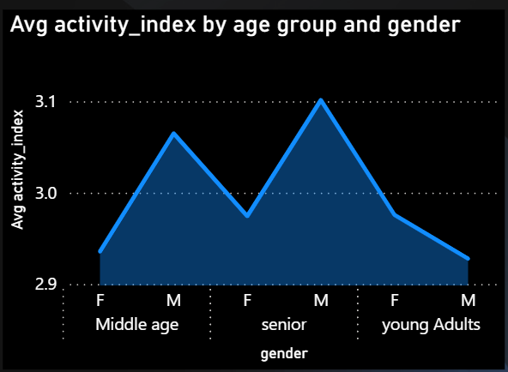
Avg Activity_index by age group and gender
Middle age group – In this group male has highest activity index with (3.6) than female with (2.94).
Senior group – Male leads with highest activity index (3.10) in all segment and female show dip (2.97).
Young Adults – Both gender drop close to the lowest activity index (2.9).

Slide 5
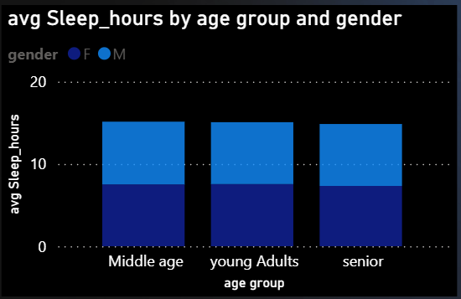
Avg Sleep_hours by age and gender
Middle Age, Young Adults, and Seniors all average a round 7–8 hours of sleep.
Sleep hours are consistent across all age groups, indicating stable rest habits regardless of life stage.

Slide 6
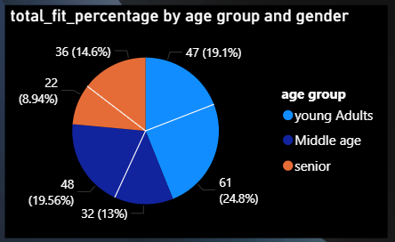
Total fit_percentage by gender and age group
Young Adults represent two segments: one with 19.1% and another with 13%. While not explicitly stated, these likely represent male and female young adults.
Young Adults and middle age together have Almost 78% rate across all percentage.

Slide 7
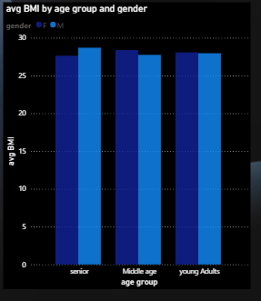
Avg BMI by Age group and gender
The average BMI for both genders seems to be highest in the "Middle age" group, approaching or slightly exceeding 28 for males and just below 28 for females.
Average BMI tends to be slightly lower in "young Adults" compared to "Middle age," and potentially decreases slightly again in the "senior" group compared to "Middle age" but remains relatively close.

Slide 8
Thank You

